Slide 1
Generating Song Lyrics Using RNN

Slide 2
Recurrent neural networks
Forward propagation in RNNs
Backpropagation through time
The vanishing and exploding gradient problem
Generating song lyrics using RNNs
Different types of RNN architectures
HANDSON_DEEP_LEARNING_ALGORITHMS_WITH_PYTHON
4 Generating Song Lyrics Using RNN

Slide 3
The Sun rises in the ____
east
If we were asked to predict the blank term in the preceding sentence, we would probably
say east. Why would we predict that the word east would be the right word here? Because
we read the whole sentence, understood the context, and predicted that the word east
would be an appropriate word to complete the sentence.

Slide 4
an RNN uses the previous hidden state as memory which captures and stores
the contextual information (input) that the network has seen so far

Slide 5
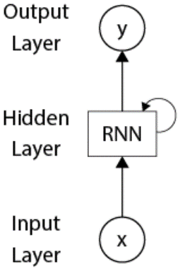
The difference between feedforward networks and RNNs

Slide 6
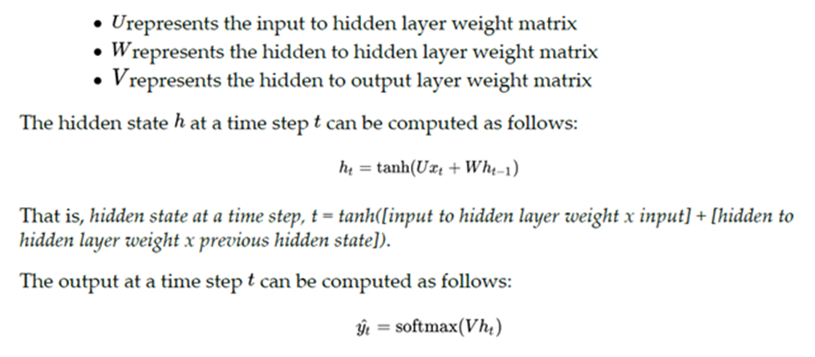

Slide 7
Forward propagation in RNNs

Slide 8
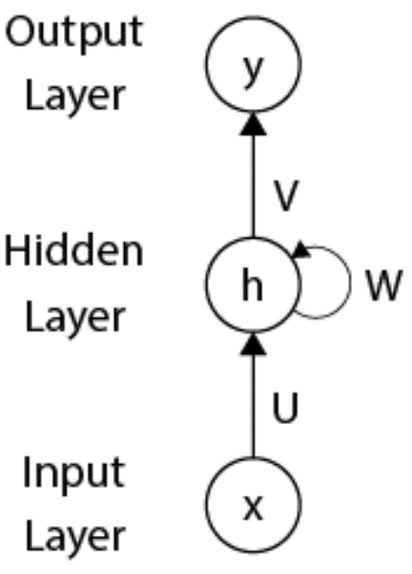
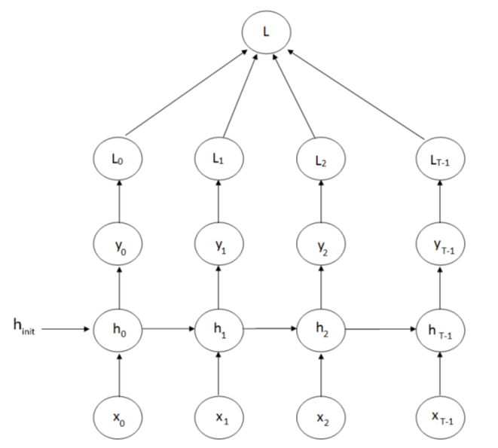
Backpropagating through time
cross-entropy loss

Slide 9
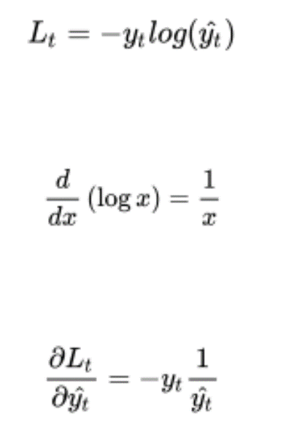
Backpropagating through time
cross-entropy loss

Slide 10
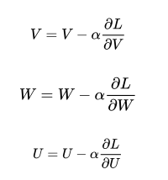

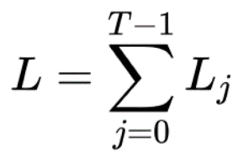
how BPTT works
Gradients with respect to the hidden to output weight, V

Slide 11
how BPTT works
Gradients with respect to the hidden to output weight, V

Slide 14
how BPTT works

Slide 15
how BPTT works

Slide 16
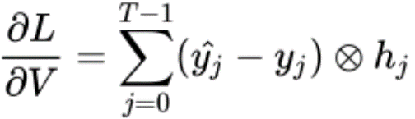
how BPTT works
Gradients with respect to the hidden to output weight, V

Slide 17
Vanishing and exploding gradients problem

Slide 18
Generating Song Lyrics Using RNN

Slide 19
Generating song lyrics using RNNs
To do this, we simply build a character-level RNN, meaning that on every
time step, we predict a new character
What a beautiful d
At the first time step,
the RNN predicts
a new character as a
What a beautiful da
What a beautiful day
word level RNN.

Slide 21

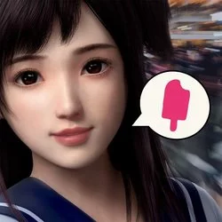
微軟人性化AI 「小冰」

Slide 22
莎士比亞 機器人
https://www.tensorflow.org/tutorials/text/text_generation

Slide 23
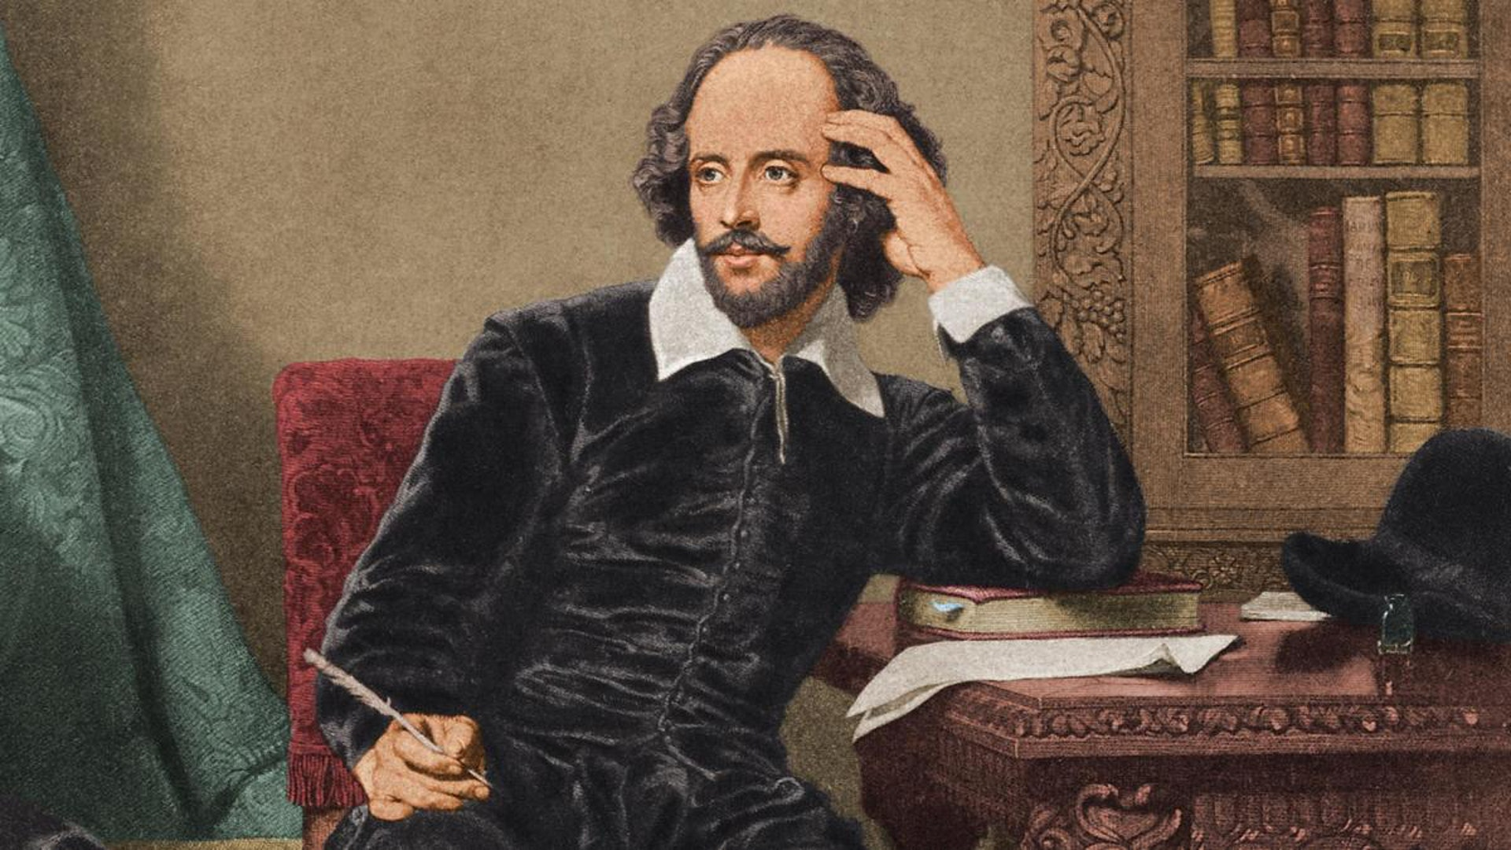
一開始輸入
ROMEO:
作文
機器人
莎士比亞
機器人
ROMEO: get thee boy:
I prithee, gamest the roguerer'd widventio.
PodP:
Alack, God he were, good met let biting jest.
DUKE OF YORK:
How! unseeath for George.

Slide 24
ROMEO: get thee boy:
I prithee, gamest the roguerer'd widventio.
PodP:
Alack, God he were, good met let biting jest.
DUKE OF YORK:
How! unseeath for George.
DUCHESS OF YORK:
Who give me my when you will asswermind
Do seept apparent pointed out;
And stands the villain.
This is not soundy mine, what is very needlock-by place,
The dark me whose understand kings,
He wakedes and her son, should resolve my sweet paward
Mothing the faults, if you varlet her;
Give noth your grace! is for Co
ICIOLANUS:
I'll ass'st up require of miserable eyes,
My sovereigns wind that we hear, my daughter.
QUEEN:
'Tis too,
'Tis reason, what is it thus I could have mar
here conceits shall have wear the living king,
May should be wark'd wite poor here, to her,
Upon the happy manes ill, have castle good
Show letters to Ghe king, or whom I care
in dangeroust in
Scental of you nightly fear the face
To wake up ungold my flyer.
MARIANA:
Yet stands a remised vast and lenged,
Her uncle Gloucester, if you juctices
On number

Slide 25
